Slide 1

Unsupervised Learning – Dry Bean Clustering
Ben Cottrell

Slide 2
Dataset Description
Main objectives
Data Exploration
Machine learning analysis and findings.
Models flaws and advanced steps.
Contents

Slide 3

Dataset

Slide 4
Dataset Overview
Machine Learning algorithms have an essential role in the agricultural sector. In this report we will discover how to implement unsupervised learning, specifically using clustering algorithms, to a dataset that has images of 13,611 grains of 7 different types of dry beans using a high-resolution camera. Within the dataset, there are a total of 16 features, 12 of which are dimensions and 4 shape forms.
KOKLU, M. and OZKAN, I.A., (2020), Multiclass Classification of Dry Beans Using Computer Vision and Machine Learning Techniques. Computers and Electronics in Agriculture, 174, 105507.
DOI: https://doi.org/10.1016/j.compag.2020.105507
Source - https://www.kaggle.com/datasets/muratkokludataset/dry-bean-dataset

Slide 5
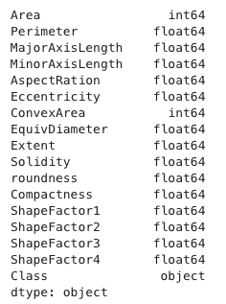
Dataset Description
Features
Area – The area of a bean zone and the number of pixels within its boundaries
Perimeter – Bean circumference is defined as the length of its border.
MajorAxisLength– The distance between the ends of the longest line that can be drawn from a bean
MinorAxisLength – The longest line that can be drawn from the bean while standing perpendicular to the main axis
AspectRation – Defines the relationship between MajorAxisLength and MinorAxisLength
Eccentricity – Eccentricity of the ellipse having the same moments as the region
ConvexArea – Number of pixels in the smallest convex polygon that can contain the area of a bean seed
EquivDiameter – Equivalent diameter: The diameter of a circle having the same area as a bean seed area
Extent – The ratio of the pixels in the bounding box to the bean area
Solidity – Also known as convexity. The ratio of the pixels in the convex shell to those found in beans.
Roundness – Calculated with the following formula: (4piA)/(P^2)
Compactness – Measures the roundness of an object

Slide 6
Dataset Description Cont.
Features
ShapeFactor1
ShapeFactor2
ShapeFactor3
ShapeFactor4
Target
Class - (Seker, Barbunya, Bombay, Cali, Dermosan, Horoz and Sira)

Slide 7

Main Objectives

Slide 8
In this section we will explore the dataset in-depth through several EDA techniques such as checking null values, data skewness, and data visualization, furthermore, showing the correlation between the features for the sake of feature engineering implementation and data cleaning.

Slide 9
Data Exploration

Slide 10
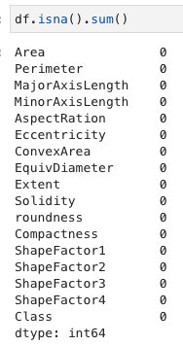
Checking for NULL values
Using the above code, we see that there are no missing values in the data set

Slide 11
Identifying Categorical and Numerical Features
These fields are numerical features as they are a mix of int64 and float64 data types
The Class feature is a categorical feature

Slide 12
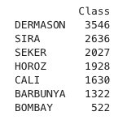
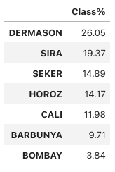
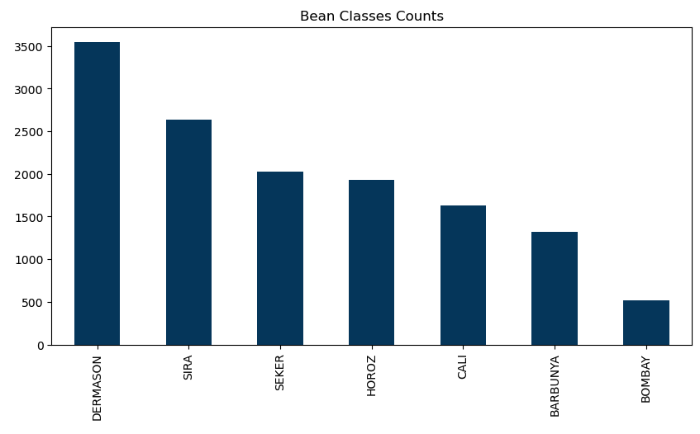
Exploring Target Variable
As shown in the ‘Bean Classes Counts’ table below, we see that we have an unbalanced data set, as the ‘BOMBAY’ and ‘BARBUNYA’ classes have lower observations than the likes of ’DERMASON’ and ‘SIRA’.

Slide 13
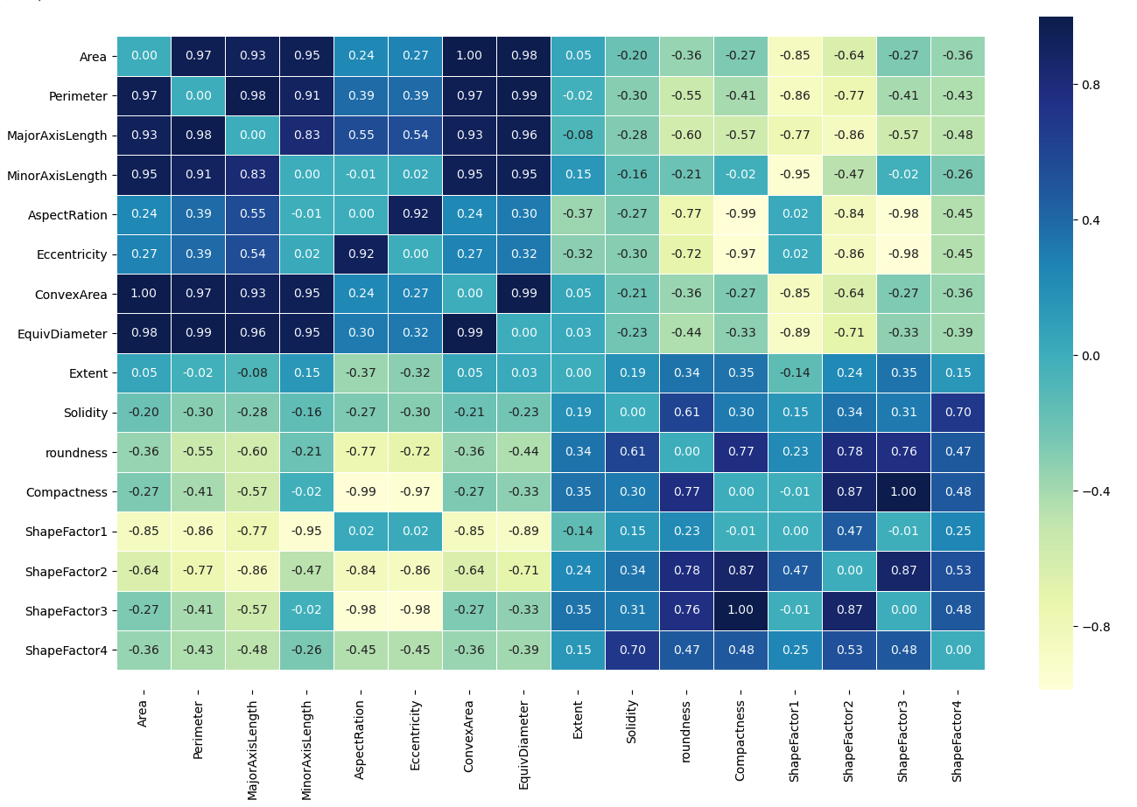
Correlation Matrix
The correlation matrix is used to show the relationship between features

Slide 14
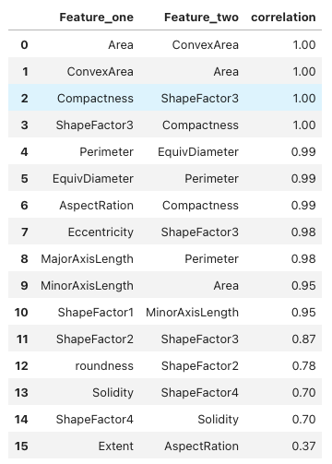
EDA - Highest Correlations Between Features
Here we see that there is a high correlation between most of the features, which is down to the features being geometric features describing the shape of the bean

Slide 15
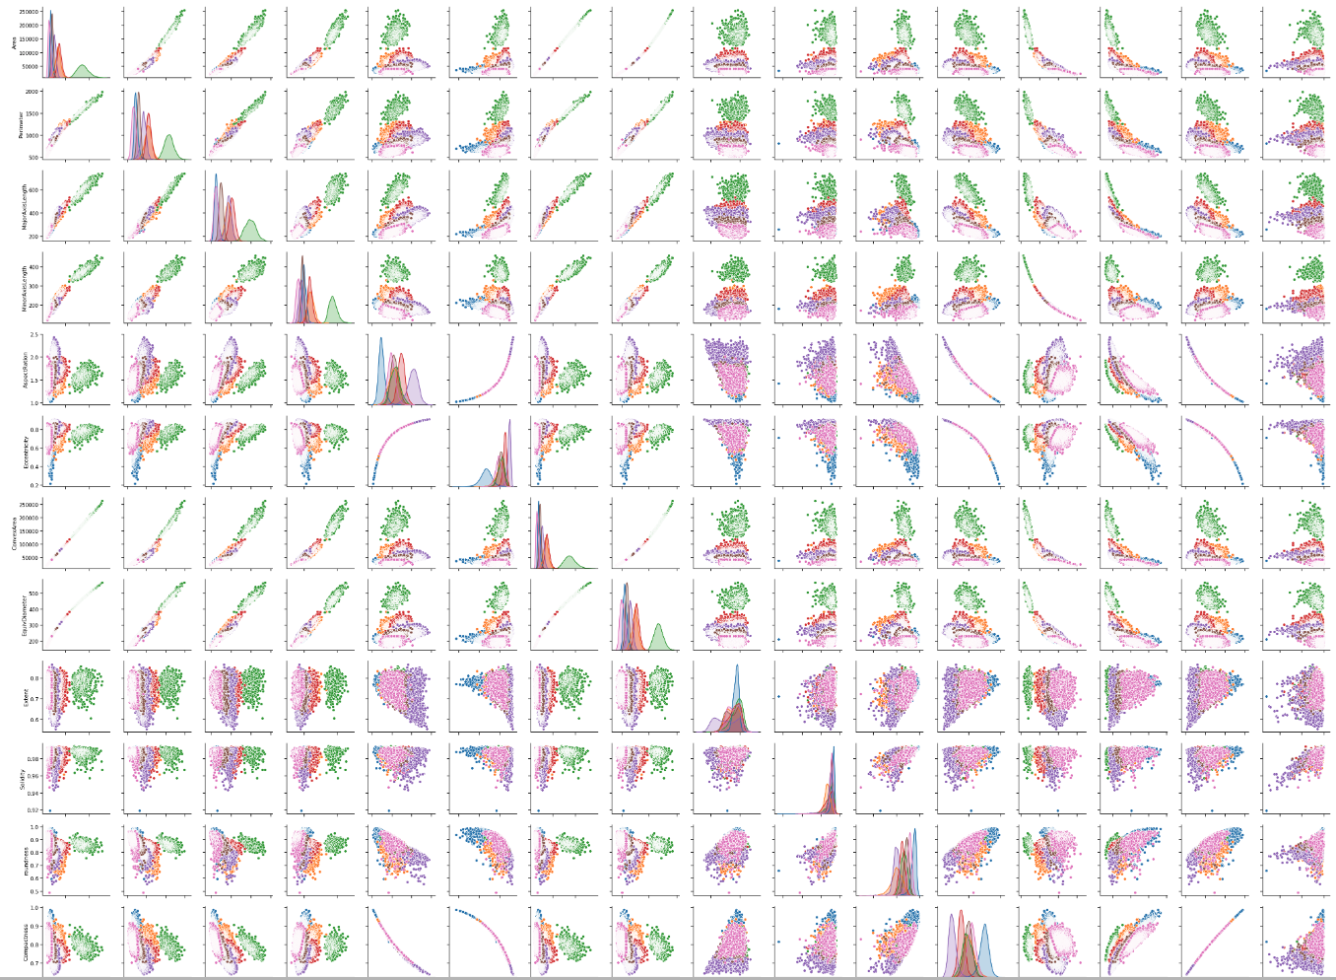
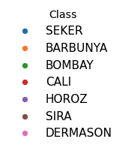
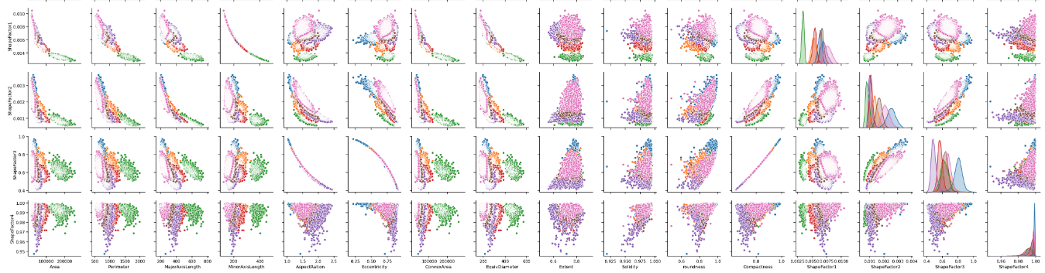
Pair Plot
Using pair plot allows us to obtain the linearity between features, as well as being able to see how the different bean classes are distributed to form the clusters

Slide 16
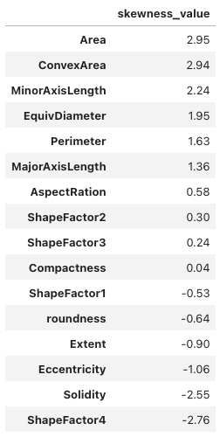
Skewness Examination
Skewness examination in the features in anticipation of transformations.
The following criteria is used for measuring skewness:
(near 0) or (-0.75 < value < 0.75) = no skewness
Positive (value > +0.75) = right skewness
negative (value <-0.75) = left skewness
When we examine the features in the table, we see several positive values and negative features, which need to be transformed using log transformation

Slide 17
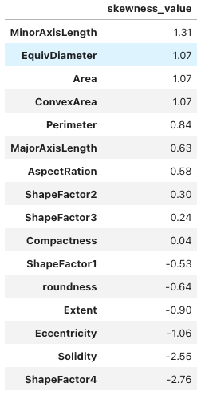
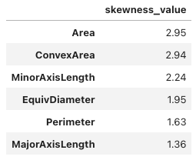
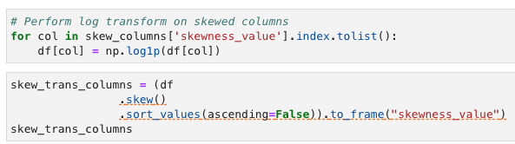
Feature Engineering – Applying Log Transformation
When log transformation is applied to features, only positive skewness will be handled as log transformation tries to approach right skewness into left skewness to reach the symmetric or normal distribution
Code to perform log transformation
Here we see MinorAxisLength, EquivDiameter, Area, ConvexArea, Perimeter and MajorAxisLength features have been transformed

Slide 18
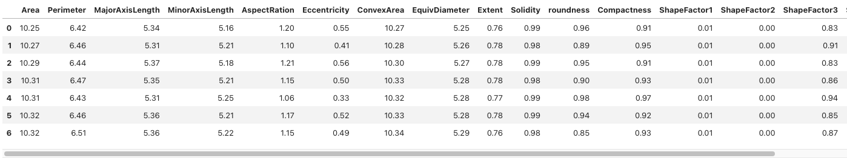
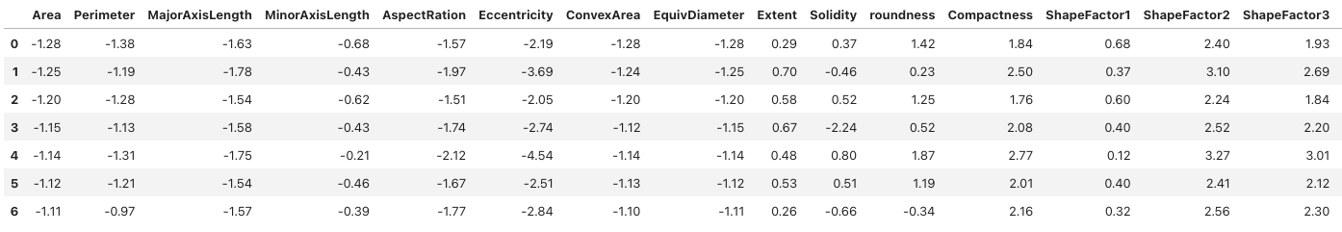
Feature Engineering – Feature Scaling
Feature scaling is relevant in machine learning models that compute distance metrics. If we are to use clustering methods such as K-Means, then we are required to scale the features to perform clustering correctly.

Slide 19
Machine Learning Analysis & Findings

Slide 20
Model Approach
The following analysis compares 4 different Clustering methods:
K-Means Algorithm
Agglomerative Clustering Algorithm
DBSCAN
MeanShift
We will use these algorithms to find the appropriate number of clusters for our data set, as well as comparing the clustered observations with the actual classes of the dry bean data set.

Slide 21
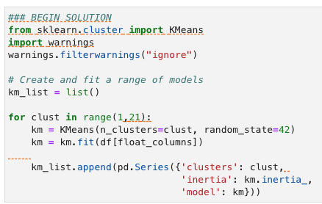
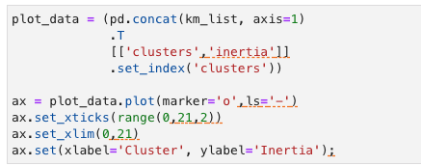
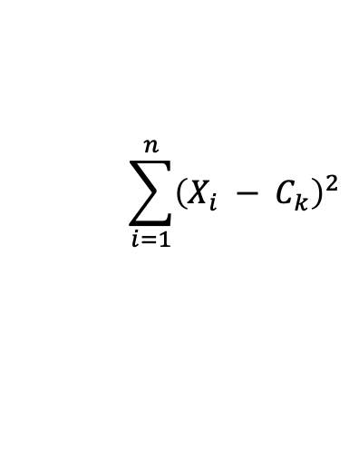
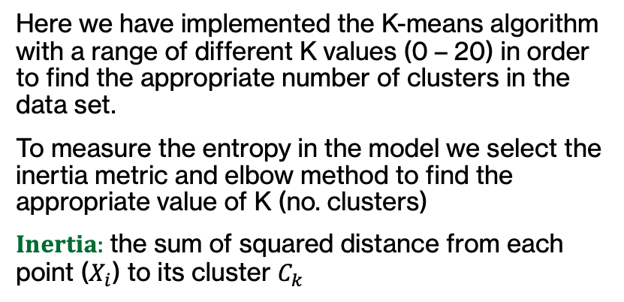
K-Means Algorithm
Here we have implemented the K-means algorithm with a range of different K values (0 – 20) in order to find the appropriate number of clusters in the data set.
To measure the entropy in the model we select the inertia metric and elbow method to find the appropriate value of K (no. clusters)
𝐈𝐧𝐞𝐫𝐭𝐢𝐚: the sum of squared distance from each point ($X_{i}$) to its cluster $C_{k}$
$$\sum_{i=1}^{n}{{\left(X_{i} − C_{k}\right)}^{2}}$$

Slide 22
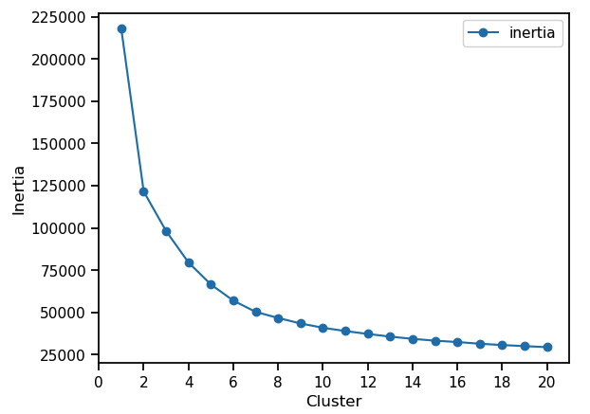
K-Means Algorithm
As shown in the graph, if we follow the elbow method approach (circled in green), we can see that the appropriate number of clusters range between 6 to 8, which aligns with the dataset as it has 7 different clusters (one for each class)

Slide 23

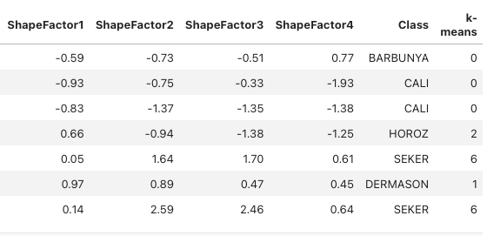
K-Means Algorithm
Apply K-Means with no of clusters = 7
After applying K-Means with no. clusters = 7 to the data set, it will then classify each observation to the 7 clusters which we assigned in the model.
Then we will be able to see how many of the observations are correctly classified.
Class Label | Cluster no
BARBUNYA | 0
DERMAZON | 1
HOROZ | 2
CALI | 3
BOMBAY | 4
SIRA | 5
SEKER | 6

Slide 24
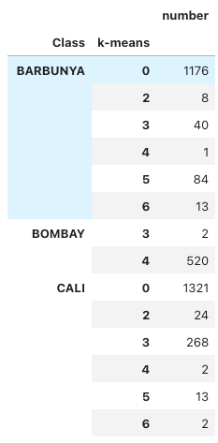
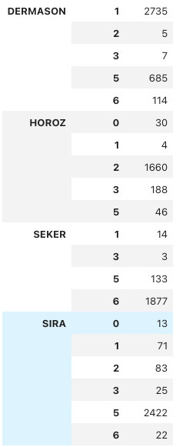
K-Means Algorithm
Below we are grouping by the Class and k-means columns in order to validate the clustering model with the labeled classes:
Cluster Index | Class Label | Correct vs Total | Correct Clustering Percentage
0 | BARBUNYA | 1176 : 1322 | 88.96%
1 | DERMASON | 2735 : 3546 | 77.13%
2 | HOROZ | 1660 : 1928 | 86.10%
3 | CALI | 268 : 1630 | 16.44%
4 | BOMBAY | 520 : 522 | 99.17%
5 | SIRA | 2422 : 2636 | 91.88%
6 | SEKER | 1877 : 2027 | 92.60%
The table above shows that the outcomes were very good for the majority of the clusters.
However, one of the clusters (CALI) achieved poor results due to having similar characteristics with the (BARBUNYA) cluster

Slide 25
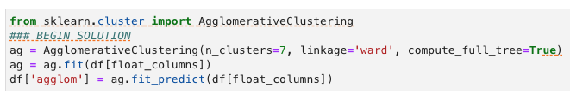
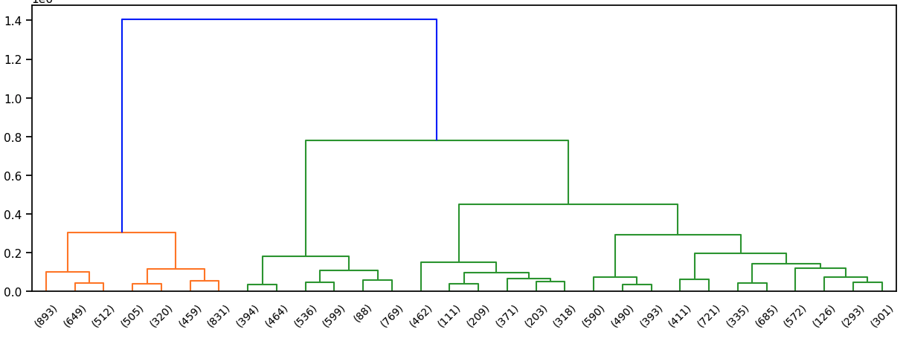
Agglomerative Clustering Algorithm
Applying agglomerative hierarchical clustering with no. clusters = 7
Class Label | Cluster no
BARBUNYA | 0
HOROZ | 1
SIRA | 2
SEKER | 3
BOMBAY | 4
DERMASON | 5
CALI | 6

Slide 26
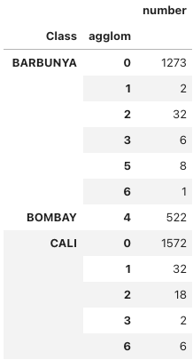
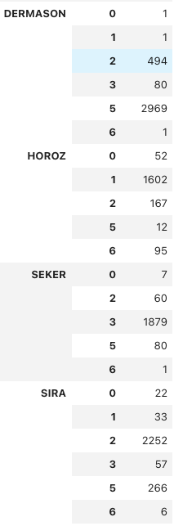
Agglomerative Clustering Algorithm
Here we group by Class and agglom columns to validate our clustering model with the actual classes labeling:
Cluster Index | Class Label | Correct vs Total | Correct Clustering Percentage
0 | BARBUNYA | 1273 : 1322 | 96.30%
5 | DERMASON | 2969 : 3546 | 83.73%
1 | HOROZ | 1602 : 1928 | 83.09%
6 | CALI | 6 : 1630 | 0.37%
4 | BOMBAY | 522 : 522 | 100%
2 | SIRA | 2252 : 2636 | 85.43%
3 | SEKER | 1879 : 2027 | 92.70%
Similar to K-Means, (CALI) Cluster achieved very poor results because of characteristics similarity (BARBUNYA) cluster

Slide 27


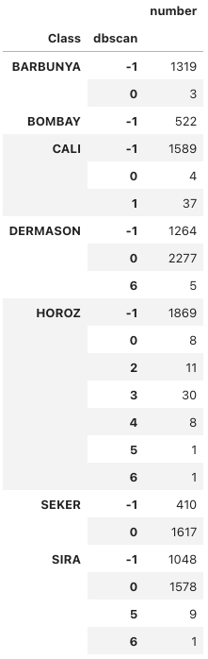
DBSCAN Algorithm
After applying the DBSCAN algorithm with different parameters to the data set, we see poor outcomes and high error, although the algorithm did predict the appropriate number of clusters.

Slide 28

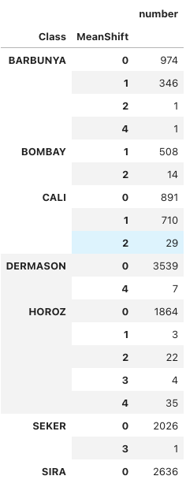
MeanShift Algorithm
Similarly to the DBSCAN algorithm in the previous slide, after applying the MeanShift algorithm with different parameters to the data set, we see poor outcomes and high error, although the algorithm did predict the appropriate number of clusters

Slide 29
Machine Learning Findings
As shown in the previous two slides, due to DBSCAN and MeanShift algorithms achieving poor results and high error in terms of clustering, these two have been excluded from the final comparison, which will focus on K-Means and Agglomerative Clustering.
Class Label | Correct K-Means Clustering Percentage | Correct Agglomerative Clustering Percentage
BARBUNYA | 88.96% | 96.30%
DERMASON | 77.13% | 83.73%
HOROZ | 86.10% | 83.09%
CALI | 16.44% | 0.37%
BOMBAY | 99.17% | 100%
SIRA | 91.88% | 85.43%
SEKER | 92.60% | 92.70%
Overall Accuracy | 92.05% | 90.03%
Both K-Means and Agglomerative algorithms achieved great accuracy but in terms of best performance, it was K-Means that achieved the higher overall accuracy with 92.05%. Therefore, this would be the recommended clustering algorithm to use.

Slide 30

Model Flaws & Next Steps

Slide 31
Models - Flaws & Strengths
K-means and agglomerative hierarchical clustering methods were both fast to run and accurate in terms of determining the appropriate number of clusters. Both models clustered the majority of bean observations correctly, with the exception of one class which was CALI. This was due to its similarities with the BARBUNYA class but despite this, both algorithms achieved above 90% in terms of clustering accuracy.
By contrast, DBSCAN and MeanShift required far more time to find the appropriate number of clusters, as they are sensitive to clustering parameters minPoints and EPS. As well as the excessive amount of time taken to create the algorithms, the outcomes of the observations were very poor, highlighting that these clustering methods are not a cost-effective solution for our data set.

Slide 32
Future Development
In terms of future development, I would consider the following:
Using images of each bean as a dataset to see if DBSCAN and MeanShift algorithms perform better, as they are commonly used in computer vision applications such as satellite images and anomaly detection
Using grid search and hyperparameters tuning for DBSCAN and MeanShift to find the best parameters, although this could result in even longer run times

Slide 33

Thank you for reading

